Slide 1
Task Presentation
From Task 1 to Present
HTMLCSJS - Siva - OCT2024

Slide 2
Tasks Contents and page no.
Task 1 - Page 3 Basic HTML
Task 2 - Page 9 Basic CSS
Task 3 - Page 16 CSS Media Query Basics
Task 4 - Page 17 JS ( file upload condition, selectors and more )
Task 5 - Page 21 JS local Storage, Session Storage, Cookies storage

Slide 3
Lets Get Started

Slide 4


21 oct 2024
Task 1
SIVASARAN
HTML
TAGS

Slide 5

BASIC HTML TAG
HTML (HyperText Markup Language) is the standard language used to create and structure content on the web. It uses a system of tags to define elements like headings, paragraphs, links, images, and more. These tags describe the structure and format of web pages for browsers to display.
In short, HTML is the foundation of every web page, allowing content to be organized and displayed.

Slide 6
Basic Tags
<!DOCTYPE html> - 🟢 Specifies the HTML document type (HTML5).
<a href="https://www.w3schools.com">Visit W3Schools!</a> - 🔗 Creates a hyperlink that opens W3Schools in a new tab.
<h1>Heading 1</h1><h6>Heading 6</h6> - 🔠 Defines heading tags; `<h1>` is the largest, `<h6>` is the smallest.
<header>Header content here.</header> - 🏠 Declares a section as header content, usually for introductory info or navigation.
<hr> - ➖ Adds a horizontal line for content separation.
<html lang="en"></html> - 🌐 Specifies the language of the HTML document (English in this case).
<input type="text" placeholder="Enter name"> - ✍️ Creates a text input field with a placeholder for user entry.

Slide 7
Basic Tags
<li>Item 1</li> - 🔹 Defines a list item. Used within `<ul>` or `<ol>` tags to denote an individual item.
<ol><li>First</li><li>Second</li></ol> - 🔢 Creates an ordered list, displaying list items in a specific sequence (e.g., 1, 2, 3).
<p>This is a paragraph.</p> - 📝 Defines a block of text as a paragraph, adding spacing before and after.
<script>alert("Hello!");</script> - ⚙️ Adds JavaScript code to HTML; in this case, creates a simple alert box displaying “Hello!”.
<small>Smaller text</small> - 🔻 Displays text in a smaller font size, often for footnotes or secondary info.
<textarea>Enter text here</textarea> - 🗒️ Creates a multi-line text input field for longer user entries.
<ul><li>Item 1</li></ul> - 🔘 Creates an unordered (bulleted) list, displaying items in a simple bullet format.

Slide 8
Basic Tags
<link rel="stylesheet" href="style.css"> - 🎨 Links an external CSS file (style.css) to style the HTML document.
<progress value="70" max="100">70%</progress> - 📊 Creates a progress bar displaying a value, often for completion percentage.
<s>Strikethrough text</s> - ✂️ Displays text with a strikethrough, indicating deletion or a correction.
<table><tr><td>Cell</td></tr></table> - 📋 Creates a table with rows (`<tr>`) and cells (`<td>`), commonly used to organize data.
<strong>Strong text</strong> - 💪 Emphasizes text with strong importance, usually rendered in bold.
<select><option>Option 1</option></select> - 🔽 Creates a dropdown menu for selecting a single option.

Slide 9

22 0ct 2024
Task 2
CASCADING STYLE SHEETS
Presented By : Sivasaran
2024

Slide 10
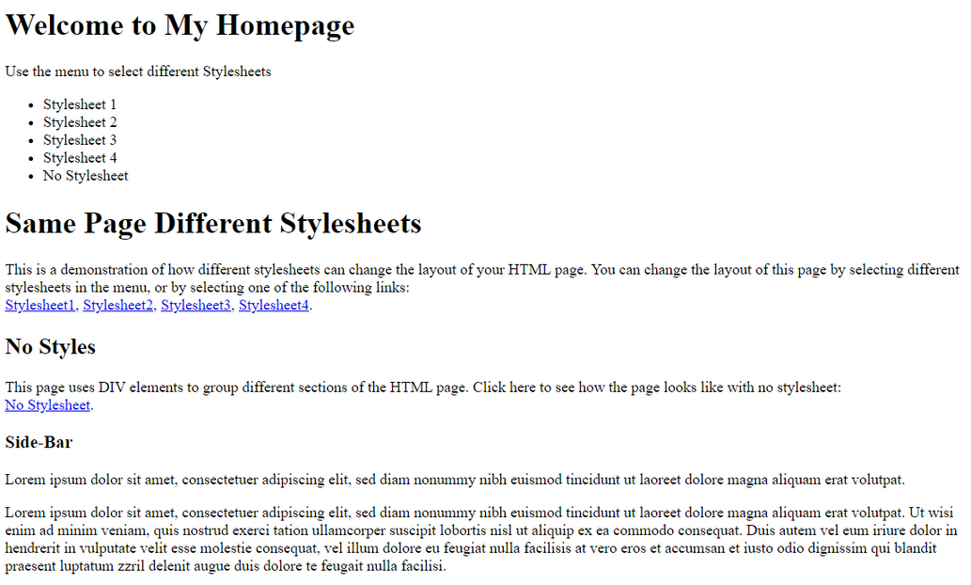
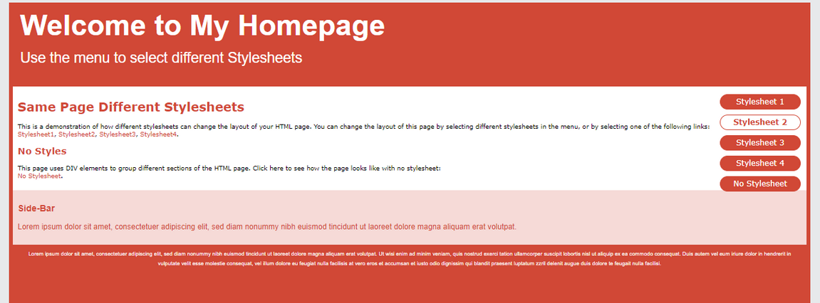
SHORT CONCLUSION
CSS is the language we use to style an HTML document.
CSS describes how HTML elements should be displayed.
css
Sivasaran

Slide 11
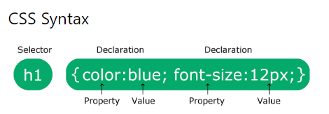
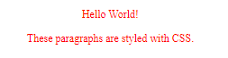
2
OVERVIEW
<body>
<p>Hello World!</p>
<p>These paragraphs are styled with CSS.</p>
</body>
<style>
p {
color: red;
text-align: center;
}
</style>
Sivasaran

Slide 12
3
External CSS - eg: style.css
Internal CSS - eg: <style></style> in head tag
Inline CSS - eg:
3 Ways to Insert CSS
}
<p style="color:red;">This is a paragraph.</p>
Element Selector - p{}
Id Selector -#id_name{}
class selector - .class_name{}
specific selector- p.class{}
multi class name- <p class="center large">
Selectors
// only p(element) with this classname
// we can use either center or large for class styles eg: p.large{}
linking:
<link rel="stylesheet" type="text/css" href="mystyle.css">

Slide 13
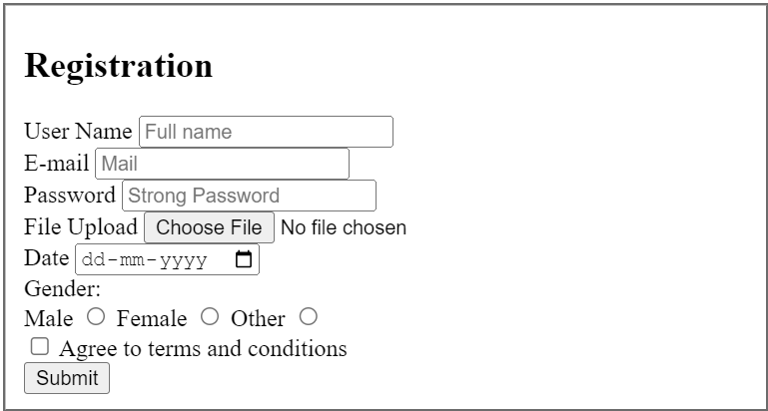
4
body {
display: flex;
justify-content: center;
align-items: center;
height: 100vh;
background-color: #f4f4f4;
font-family: Arial, sans-serif;
}
fieldset {
padding: 20px;
background-color: white;
border-radius: 8px;
width: 300px;
}
input, button {
width: 100%;
padding: 10px;
margin-bottom: 15px;
border-radius: 5px;
border: 1px solid #ccc;
}
.gender-group, .checkbox-group {
display: flex;
justify-content: center;
margin-bottom: 15px;
}
button {
background-color: #ed1703;
color: #fff;
cursor: pointer;
}
button:hover {
background-color: #45a049;
}
+

Slide 14
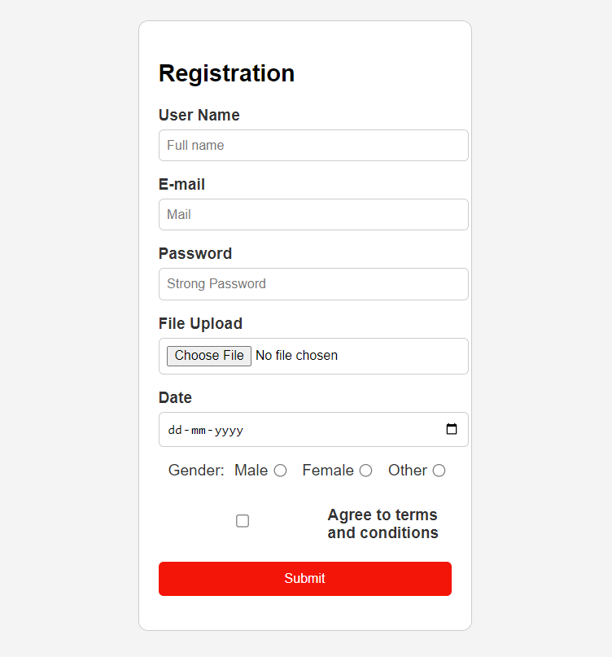
5
Output:

Slide 15
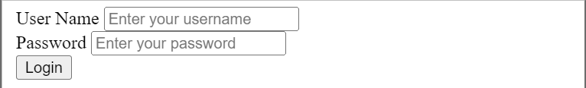
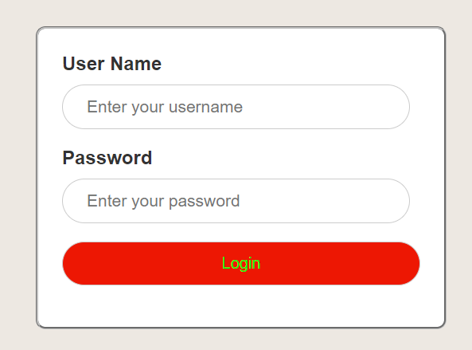
6
Before css:
body {
display: flex;
justify-content: center;
align-items: center;
height: 100vh;
background-color: #f4f4f4;
font-family: Arial, sans-serif;
}
fieldset {
padding: 20px;
background-color: white;
border-radius: 8px;
width: 300px;
}
input, button {
width: 100%;
padding: 10px;
margin-bottom: 15px;
border-radius: 5px;
border: 1px solid #ccc;
}
.gender-group, .checkbox-group {
display: flex;
justify-content: center;
margin-bottom: 15px;
}
button {
background-color: #ed1703;
color: #fff;
cursor: pointer;
}
button:hover {
background-color: #45a049;
}
After css:

Slide 16
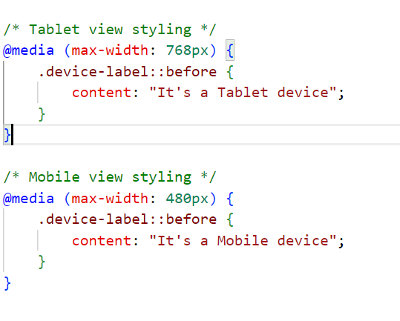
Task 3
Added Media Query
Few Types:
1. Extra Small Devices (Phones, Portrait mode)
- Example: `@media (max-width: 480px) { }`
2. Small Devices (Phones, Landscape mode)
- Example: `@media (min-width: 481px) and (max-width: 768px) { }`
3. Medium Devices (Tablets, Portrait and Landscape mode)
- Example: `@media (min-width: 769px) and (max-width: 1024px) { }`
4. Large Devices (Laptops and Small Desktops)
- Example: `@media (min-width: 1025px) and (max-width: 1200px) { }`
5. Extra Large Devices (Large Desktops and TVs)
- Example: `@media (min-width: 1201px) { }`

Slide 17
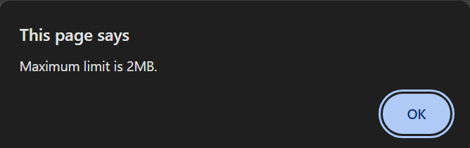
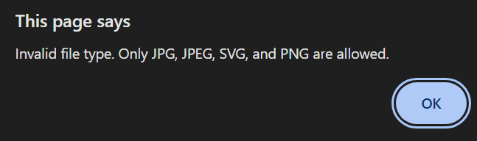
Task 4
Javascript Introduction
File Upload Condition Added
function max_size(input) {
const max = 2 * 1024 * 1024; // 3 MB in bytes
const file = input.files[0];
if (file) {
// Check file size
if (file.size > max) {
alert("Maximum limit is 2MB.");
console.log("File size exceeds 3MB limit.");
let x =document.getElementsByClassName(".device-label").value;
console.log(x)
}
// Check file type
const allowedTypes = ['image/jpeg', 'image/png', 'image/svg+xml'];
if (!allowedTypes.includes(file.type)) {
alert("Invalid file type. Only JPG, JPEG, SVG, and PNG are allowed.");
console.log("Invalid file type:", file.type);
input.value = ""; // Clear the input if type is invalid
}
}
}
HTML:
<label>File Upload</label>
<input type="file" id="fileload" onchange="max_size(this)">

Slide 18

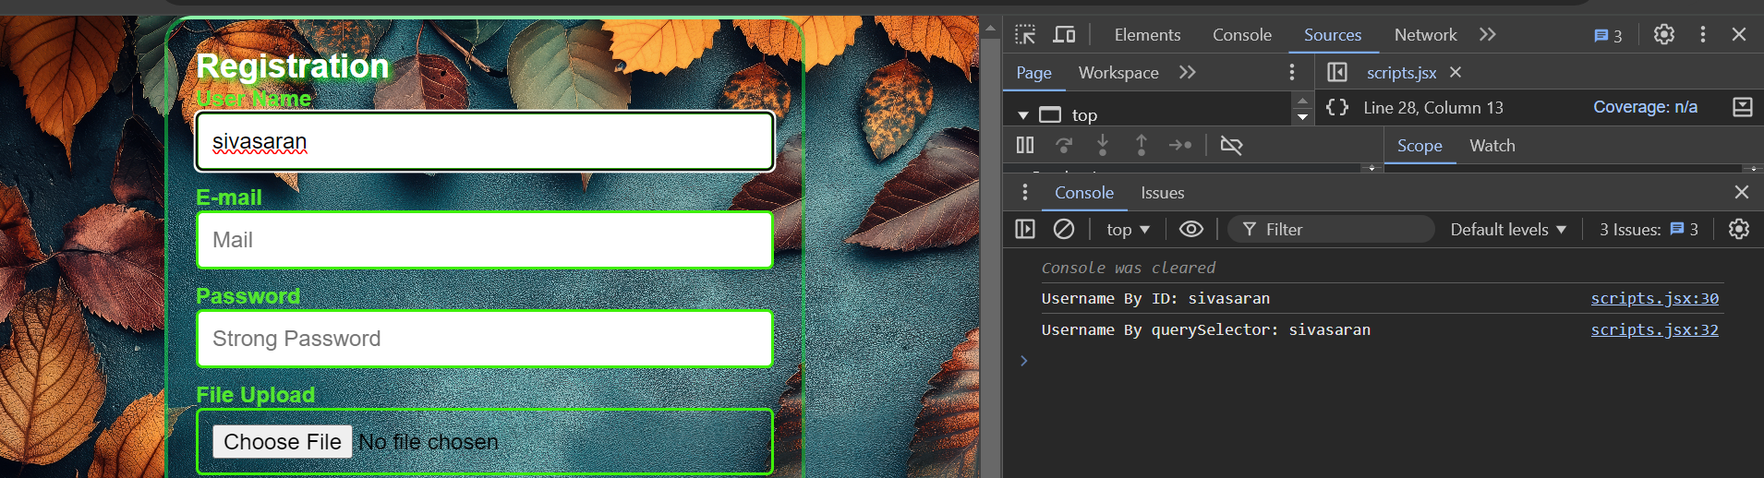
Selectors
function n(input) {
console.clear();
const username = document.getElementById("Username").value
console.log("Username By ID:", username);
const querySelector = document.querySelector("#Username").value;
console.log("Username By querySelector:", querySelector);
}
function mail(input) {
console.clear();
const emailByClass = document.getElementsByClassName("m")[0].value;
console.log("class:", emailByClass);
const QuerySelector = document.querySelector(".m").value;
console.log("querySelector:", QuerySelector);
}
GetElementById, Class, Query selector
HTML:
<label for="Username">User Name</label>
<input type="text" id="Username" placeholder="Full name" oninput="n(this)"><br>
<label for="email">E-mail</label>
<input type="email" class="m" id="email" placeholder="Mail" oninput="mail(this)"><br>

Slide 19
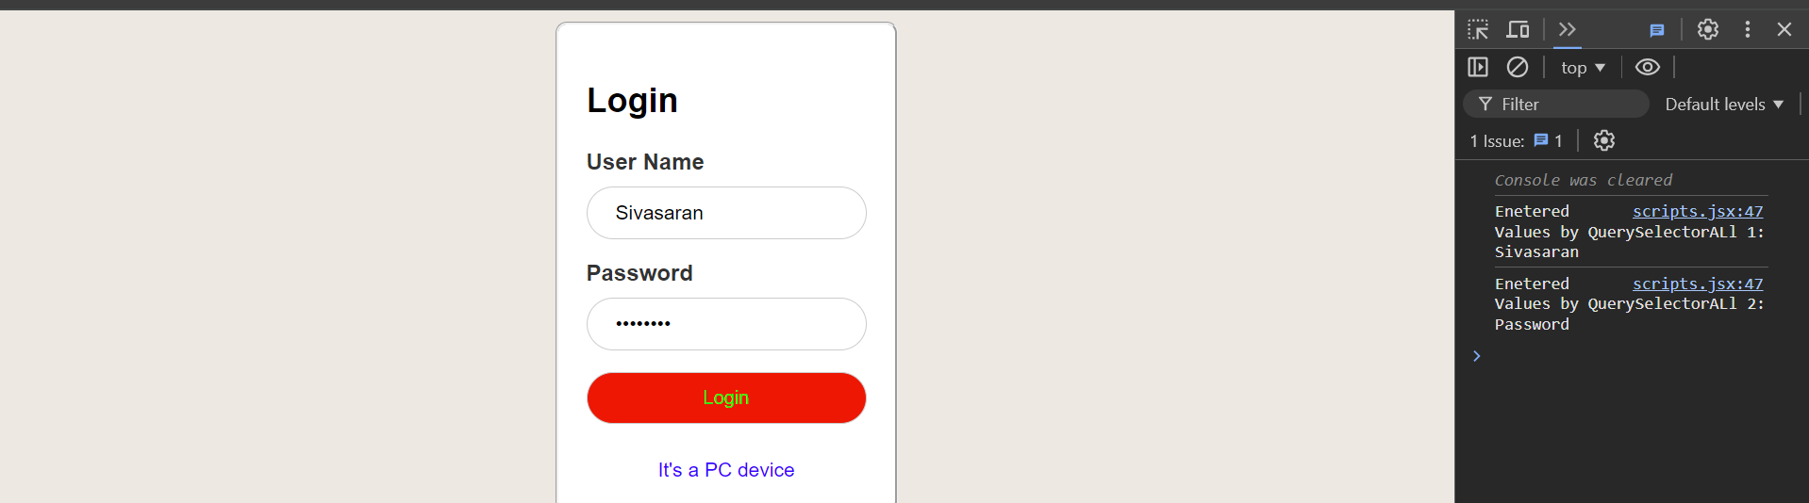
Selectors
QuerySelectorAll
HTML
<label for="UserName">User Name</label>
<input id="UserName" class="x" type="text" placeholder="Enter your username" required ><br>
<label for="password">Password</label>
<input id="password" class="x" type="password" placeholder="Enter your password" required><br>
JAVASCRIPT:
function xx() { // Corrected 'functions' to 'function'
const x = document.querySelectorAll(".x"); // Select all elements with class "x"
console.clear();
// Log the values of each input field
x.forEach((val, i) => {
console.log(`Enetered Values by QuerySelectorALl ${i + 1}:`, val.value); // Log the value of each input
});
}

Slide 20
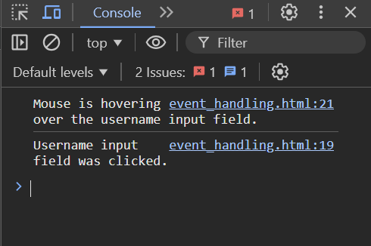
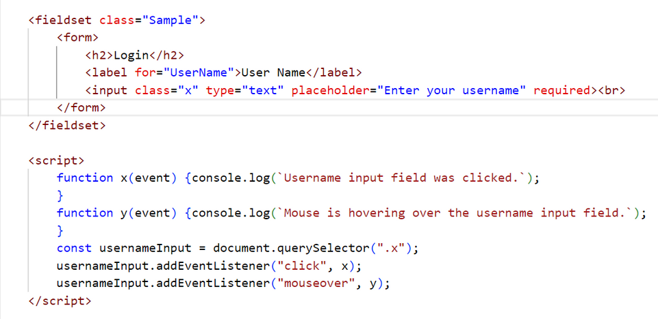
Event handling sample

Slide 21
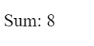
Task 5
25 OCT 2024
Class Sample
<!DOCTYPE html>
<html>
<body>
<p id="1">Hi</p>
<script>
class Xxx {
constructor(x, y) {
this.run = x;
this.fun = y;
}
sample() { // Removed 'function' keyword, corrected method syntax
return this.run + this.fun;
}
}
let summa = new Xxx(4, 4); // Create an instance of Xxx
document.getElementById("1").innerHTML = "Sum: " + summa.sample();
</script>
</body>
</html>
Output:

Slide 22
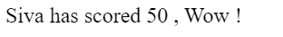
Class Inheritance
HTML
JS
<script>
class Student {
constructor(name) {
this.n = name;
}
fun1(x, y) {
return this.n + " is a topper";
}
}
class Marks extends Student {
constructor(name, marks) {
super(name); // Calls the parent class constructor
this.m = marks;
}
fun2(z, a) {
return this.n + " has scored " + this.m + " , Wow !";
}
}
let xx = new Marks("Siva", 50);
document.getElementById("1").innerHTML = xx.fun2(2, 3) ;
</script>
<!DOCTYPE html>
<html>
<body>
<p id="1">Hi</p>
</body>
</html>
Output:
Add a little bit of body text

Slide 23
Form Validation By Script
HTML
JS
<body>
<fieldset>
<form action="/submit" method="POST">
<h2 style="color: #ffffff; text-shadow: 2px 2px 5px rgb(13, 248, 29);">Registration</h2>
<label for="Username">User Name</label>
<input type="text" id="Username" placeholder="Full name" oninput="n(this)"><br>
<label for="email">E-mail</label>
<input type="email" class="m" id="email" placeholder="Mail" oninput="mail(this)"><br>
<label for="password">Password</label>
<input type="password" id="password" placeholder="Strong Password"><br>
<label>File Upload</label>
<input type="file" id="fileload" onchange="max_size(this)"><br>
<label for="date">Date</label>
<input type="date" id="date"><br>
<div class="gender-group">
<label class="gender-label">Gender:</label>
<label for="m"><input type="radio" id="m" name="Gender"> Male</label>
<label for="f"><input type="radio" id="f" name="Gender"> Female</label>
<label for="o"><input type="radio" id="o" name="Gender"> Other</label>
</div>
<div class="checkbox-group">
<input type="checkbox" id="terms" required>
<label for="terms">Agree to terms and conditions</label>
</div>
<button type="submit">Submit</button>
<div class="device-label"></div>
</form> </fieldset></body>
document.addEventListener("DOMContentLoaded", function() {
document.querySelector("form").addEventListener("submit", function(event) {
let errorMessage = "";
const username = document.getElementById("Username").value.trim();
const email = document.getElementById("email").value.trim();
const password = document.getElementById("password").value.trim();
const date = document.getElementById("date").value.trim();
const file = document.getElementById("fileload").files.length;
const gender = document.querySelector("input[name='Gender']:checked");
const terms = document.getElementById("terms").checked;
if (!username || !email || !password || !date || file === 0 || !gender || !terms) {
if (!username) errorMessage += "Please enter your username.\n";
if (!email) errorMessage += "Please enter your email.\n";
if (!password) errorMessage += "Please enter your password.\n";
if (!date) errorMessage += "Please select a date.\n";
if (file === 0) errorMessage += "Please upload a file.\n";
if (!gender) errorMessage += "Please select your gender.\n";
if (!terms) errorMessage += "You must agree to the terms and conditions.\n";
alert(errorMessage);
event.preventDefault();
}
});
});

Slide 24
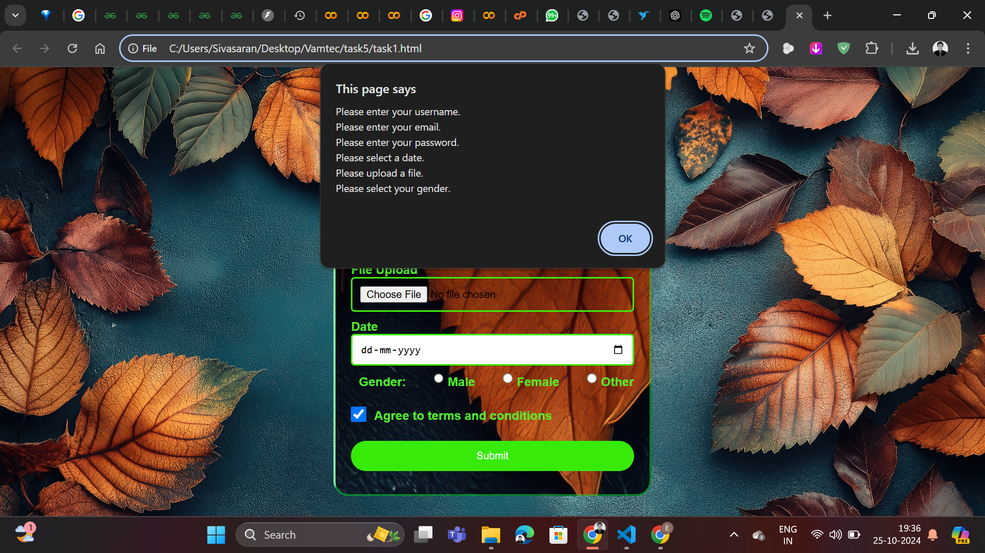
Output:

Slide 25
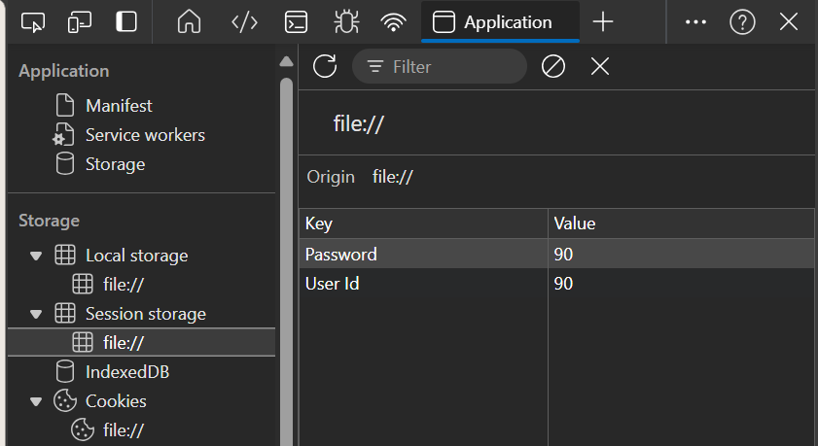
Session, local storage & Cookies
HTML
JS
<fieldset class="Sample">
<form > <h2> Login</h2>
<label for="UserName">User Name</label>
<input id="UserName" class="x" type="text" placeholder="Enter your username" required><br>
<label for="password">Password</label>
<input id="password" class="x" type="password" placeholder="Enter your password" required><br>
<button type="button" onclick="xx(); storage(event);">Login</button>
<div class="device-label"></div>
</form> </fieldset>
function storage(event) {
event.preventDefault();
var id = document.getElementById("UserName").value;
var password = document.getElementById("password").value;
sessionStorage.setItem("User Id", id);
sessionStorage.setItem("Password", password);
localStorage.setItem("User Id", id);
localStorage.setItem("Password", password);
document.cookie = `User ID=${id}; path=/; SameSite=Lax`;
document.cookie = `Password=${password}; path=/; SameSite=Lax`;
alert("Form data has been saved to sessionStorage, localStorage, and cookies!");
console.log("sessionStorage:", sessionStorage.getItem("User Id"), sessionStorage.getItem("Password"));
console.log("localStorage:", localStorage.getItem("User Id"), localStorage.getItem("Password"));
}

Slide 26
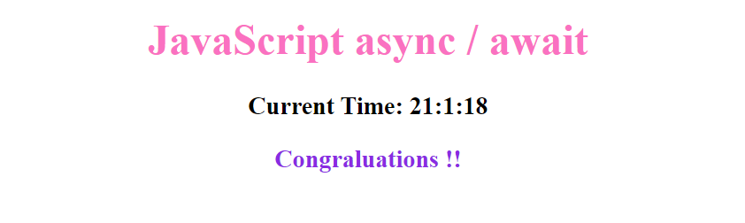
Task 6 Async/Await
HTML CSS
<h1 style="text-align: center; color: rgb(250, 113, 193);">JavaScript async / await</h1>
<h3 id="z1" style="text-align: center;"> </h3>
<h3 id="z" style="text-align: center; color: blueviolet;">Wait 5 seconds (5000 milliseconds) for this page to change.</h3>
JS
setInterval( xxx, 100);
function xxx() {
let x=new Date();
let y="Current Time: "+x.getHours() + ":" + x.getMinutes() + ":" + x.getSeconds();
document.getElementById("z1").innerHTML = y
}
async function y() {
let x = new Promise((resolve) =>{
setTimeout(function() {resolve("Congraluations !!");}, 5000);
});
document.getElementById("z").innerHTML = await x;
}
y();

Slide 27


Typescript Introduction
TypeScript is a superset of JavaScript that adds static typing to the language. This means you can specify types for variables, function parameters, and return values, making your code more reliable and less prone to errors. TypeScript compiles to JavaScript, so it can run in any environment that supports JavaScript, like browsers or Node.js
}
TypeScript Code , filename.ts
function greet(name: string): string {
return "Hello, " + name; }
console.log(greet("John")); // Output: Hello, John
// console.log(greet(42)); // Error: Argument of type 'number' is not assignable to parameter of type 'string'.
JS Code
filename.js
function greet(name) {
return "Hello, " + name;
}
console.log(greet("John"));
Cmd Prompt:
npx tsc filename.ts

Slide 28
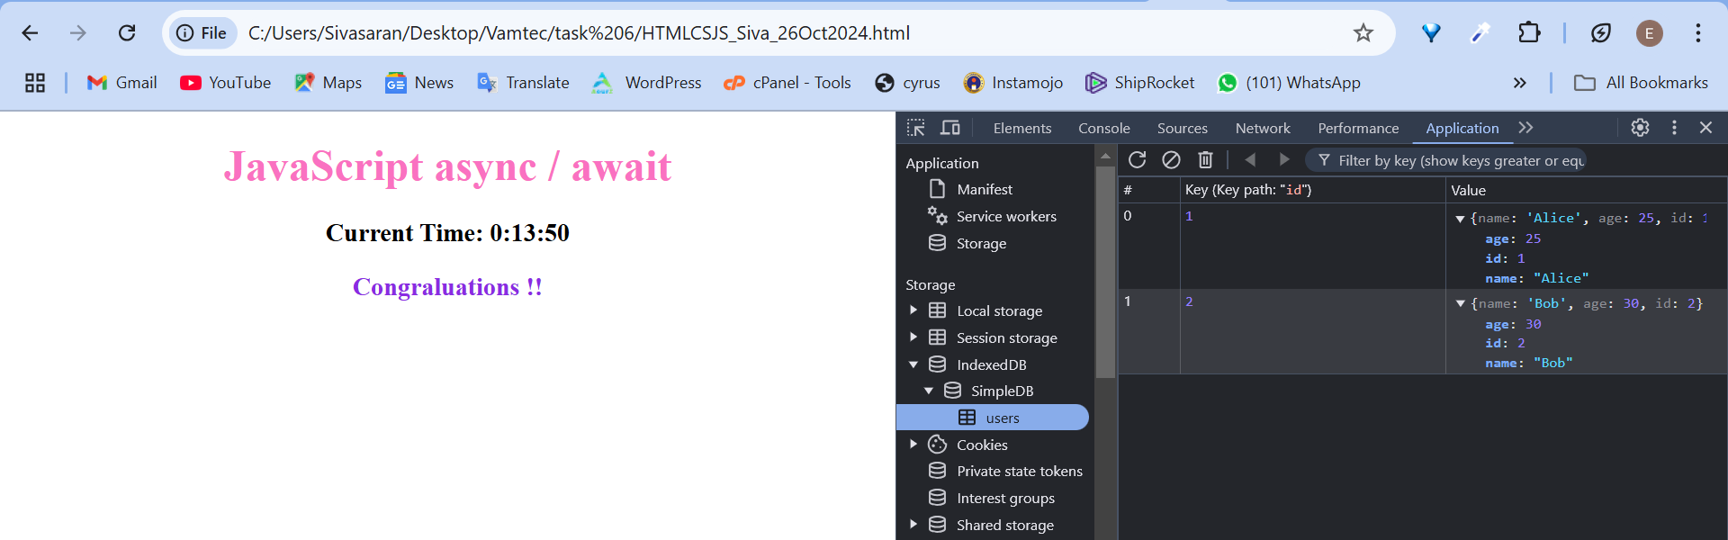
IndexedDB Introduction
IndexedDB is a low-level API in JavaScript that allows you to store large amounts of data inside a user's browser, enabling offline access and fast, structured data storage. Unlike localStorage or sessionStorage, which only store strings, IndexedDB lets you store rich data types such as objects, arrays, and even files
let request = indexedDB.open("SimpleDB", 1);
request.onupgradeneeded = (e) => // event has passed obj as e
e.target.result.createObjectStore("users", { keyPath: "id", autoIncrement: true });
//e.target.result. is a instance
//createObjectStore() is a event
request.onsuccess = (e) => { // event has passed obj as e
let store = e.target.result.transaction("users", "readwrite").objectStore("users");
//e.target.result. is a instance
//createObjectStore(), objectStore() is a event
store.add({ name: "Alice", age: 25 }); //store data
store.add({ name: "Bob", age: 30 }); //store data
console.log("Data added successfully");
};

Slide 29
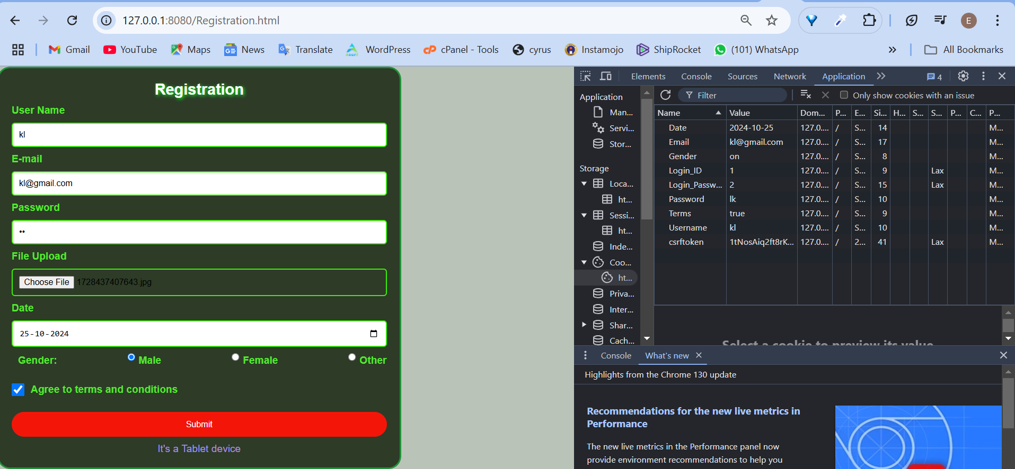
Alternate server for Cookies Storage
npm install -g http-server
http-server // http-server -p 3000
npm install -g live-server
live-server

Slide 30
THANK YOU
Presented By :Sivasaran

